Slide 1

Overview of Cryptography and Cryptocurrency
Telkom University

Slide 2

Main Questions as a Student
What is Bitcoin and Blockchain? Why it may be a catalyst for big change in financial sector?
Why so many people talk about Bitcoin and Blockchain, but no one really understand how it works?
How Bitcoin and Blockchain works and who initiated those technologies?
How to learn Bitcoin and Blockchain technologies?
What I can learn out of this course? Your motivations and questions will define the results!

Slide 3
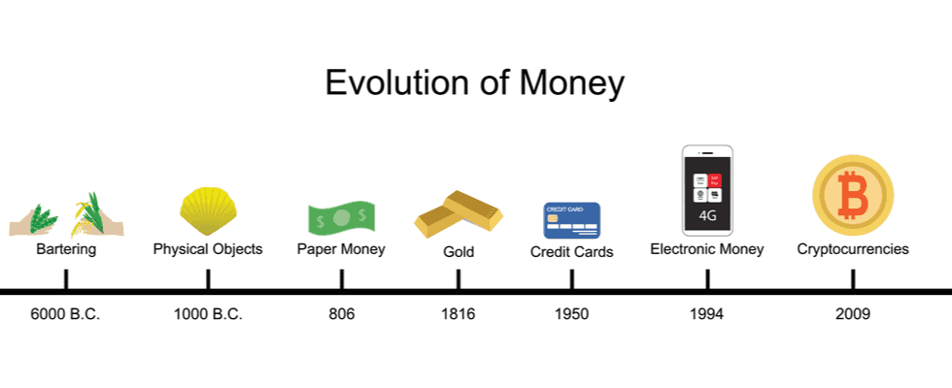
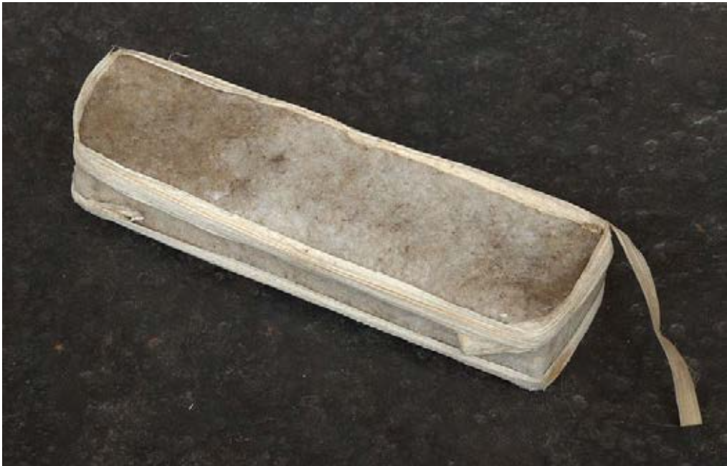




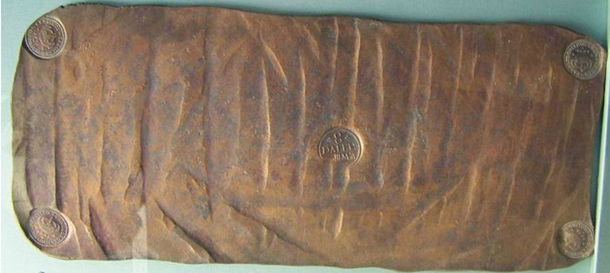
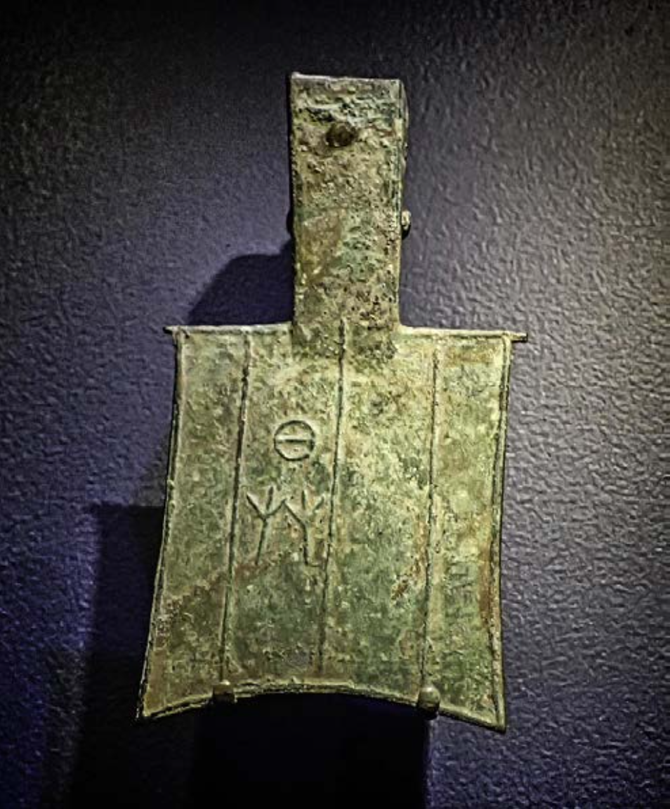
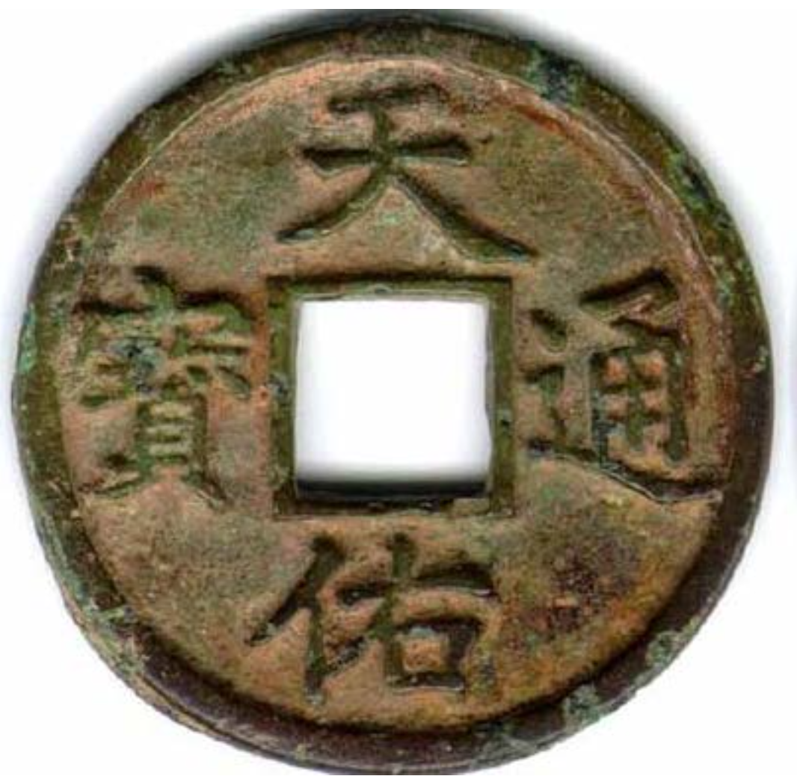
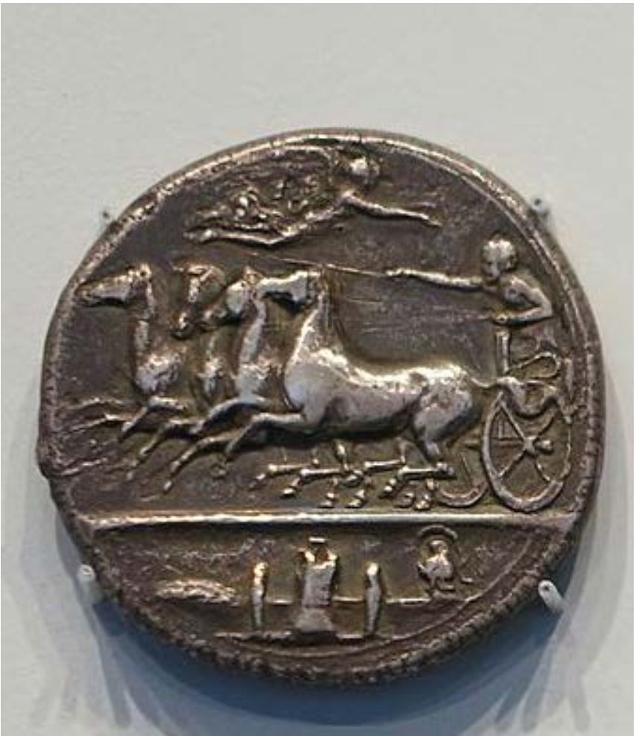
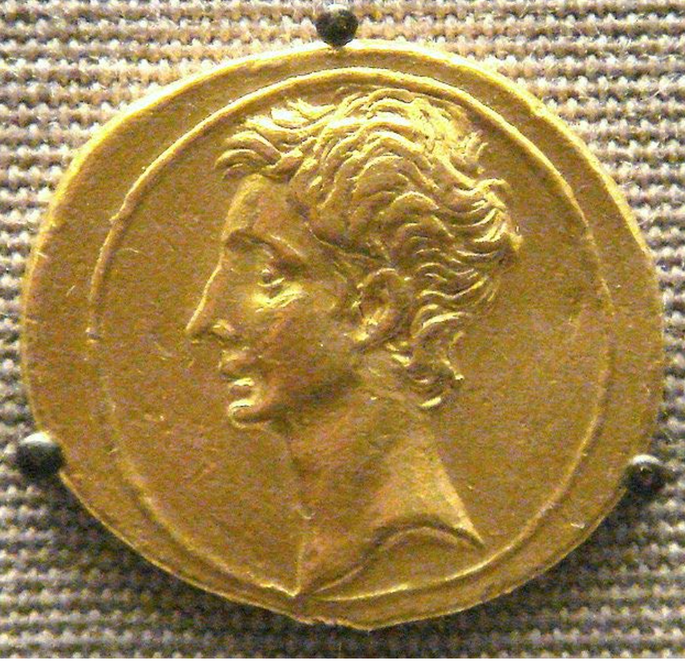
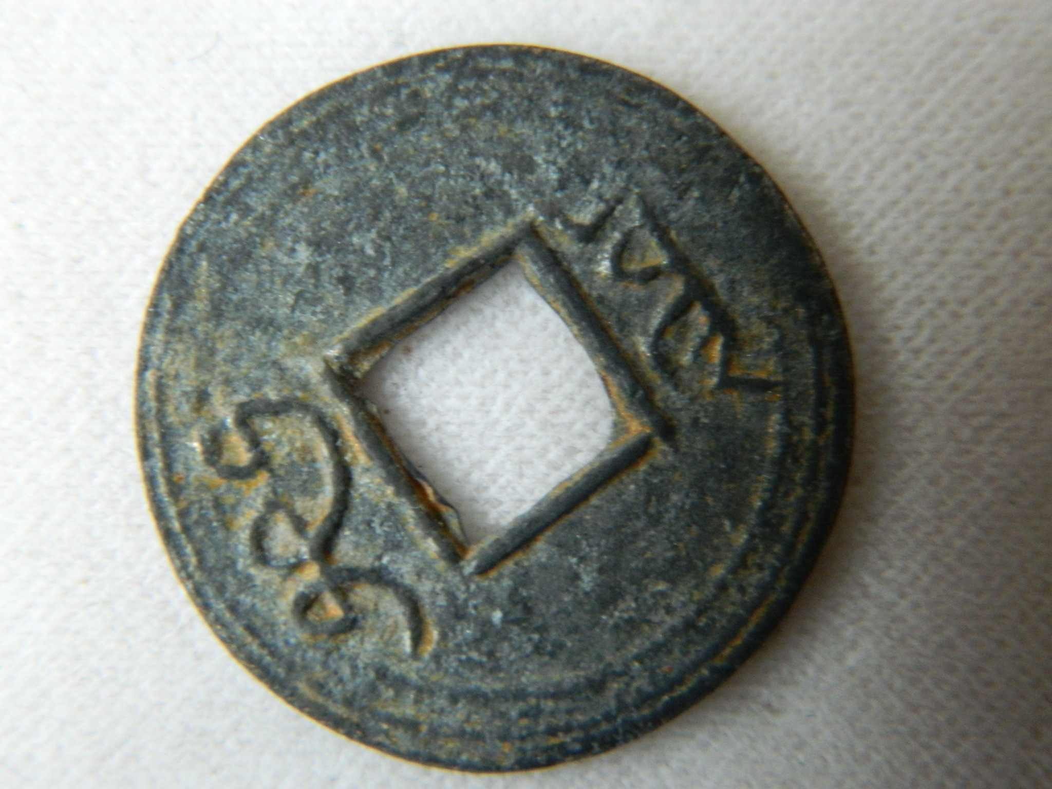

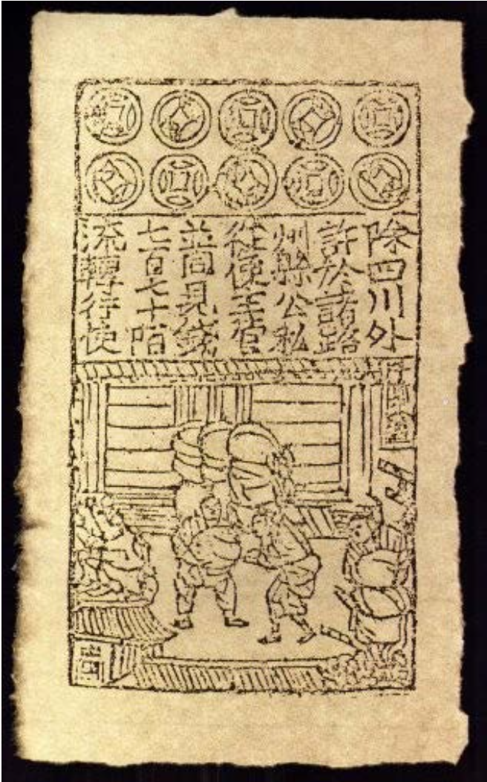
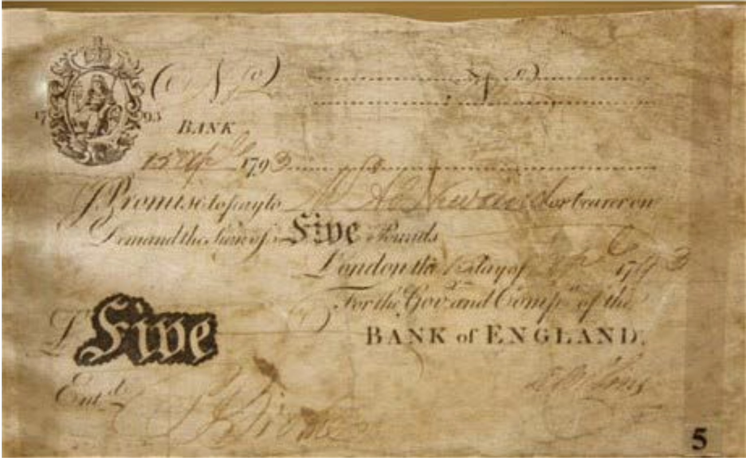
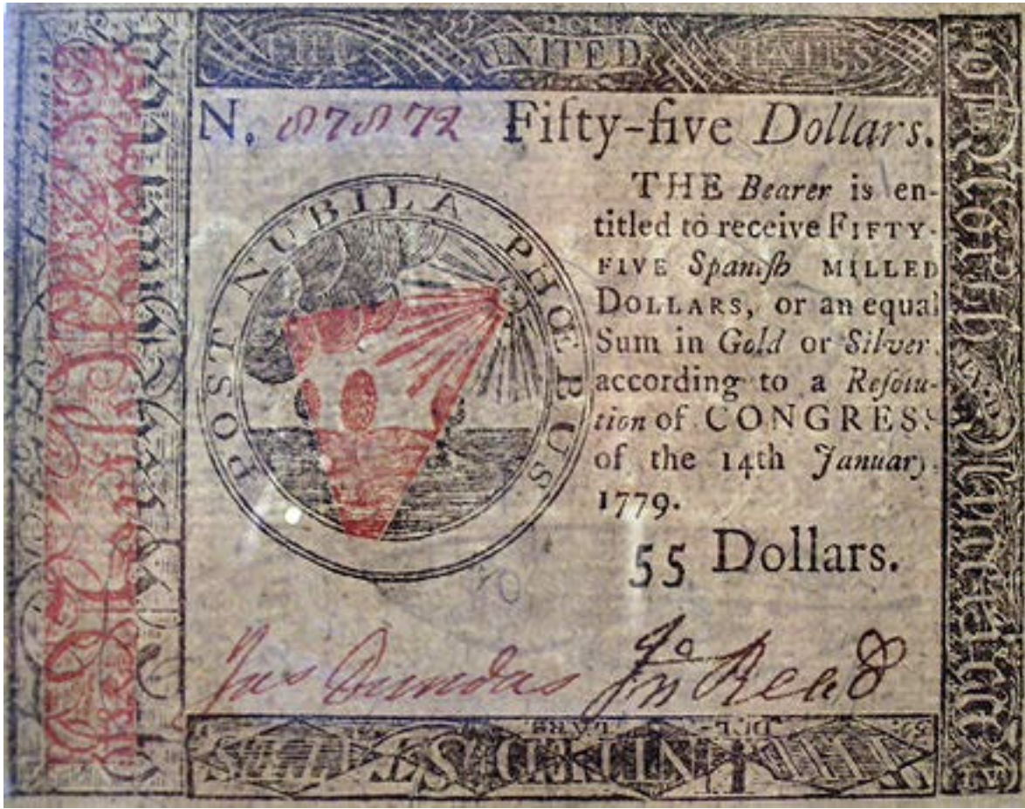
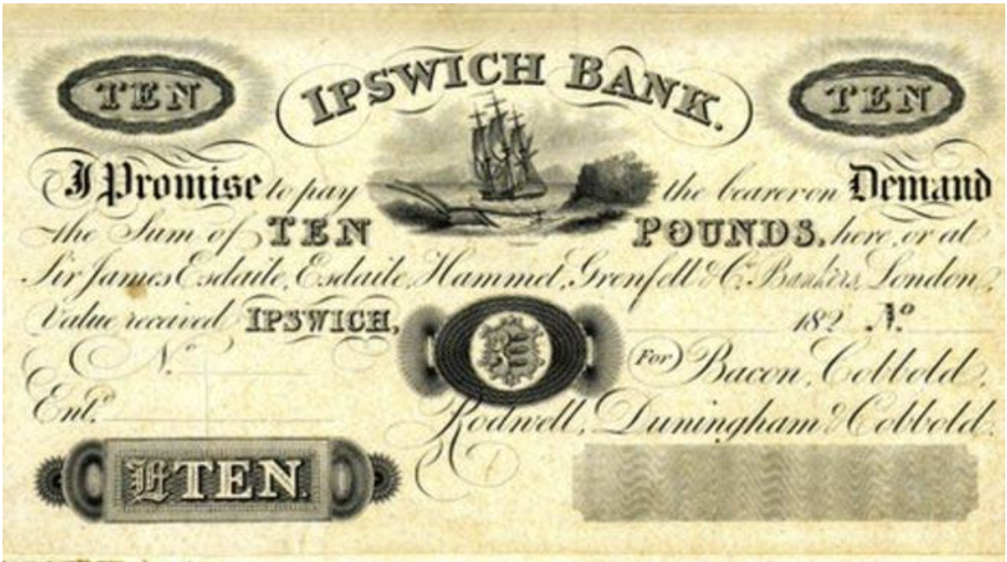
History of Money
The Role of Money
Measure of Value
Medium of Exchange
Unit of Account
The History
Bartering
Cash vs Credit
Electronic
Cryptocurrency

Slide 4
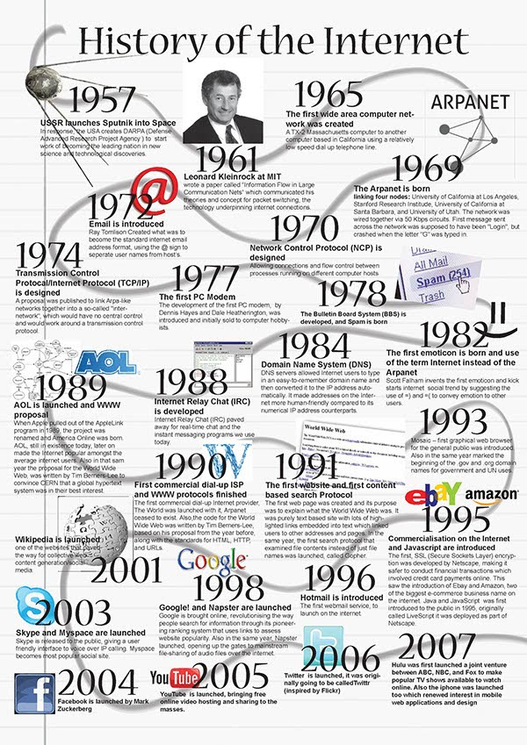
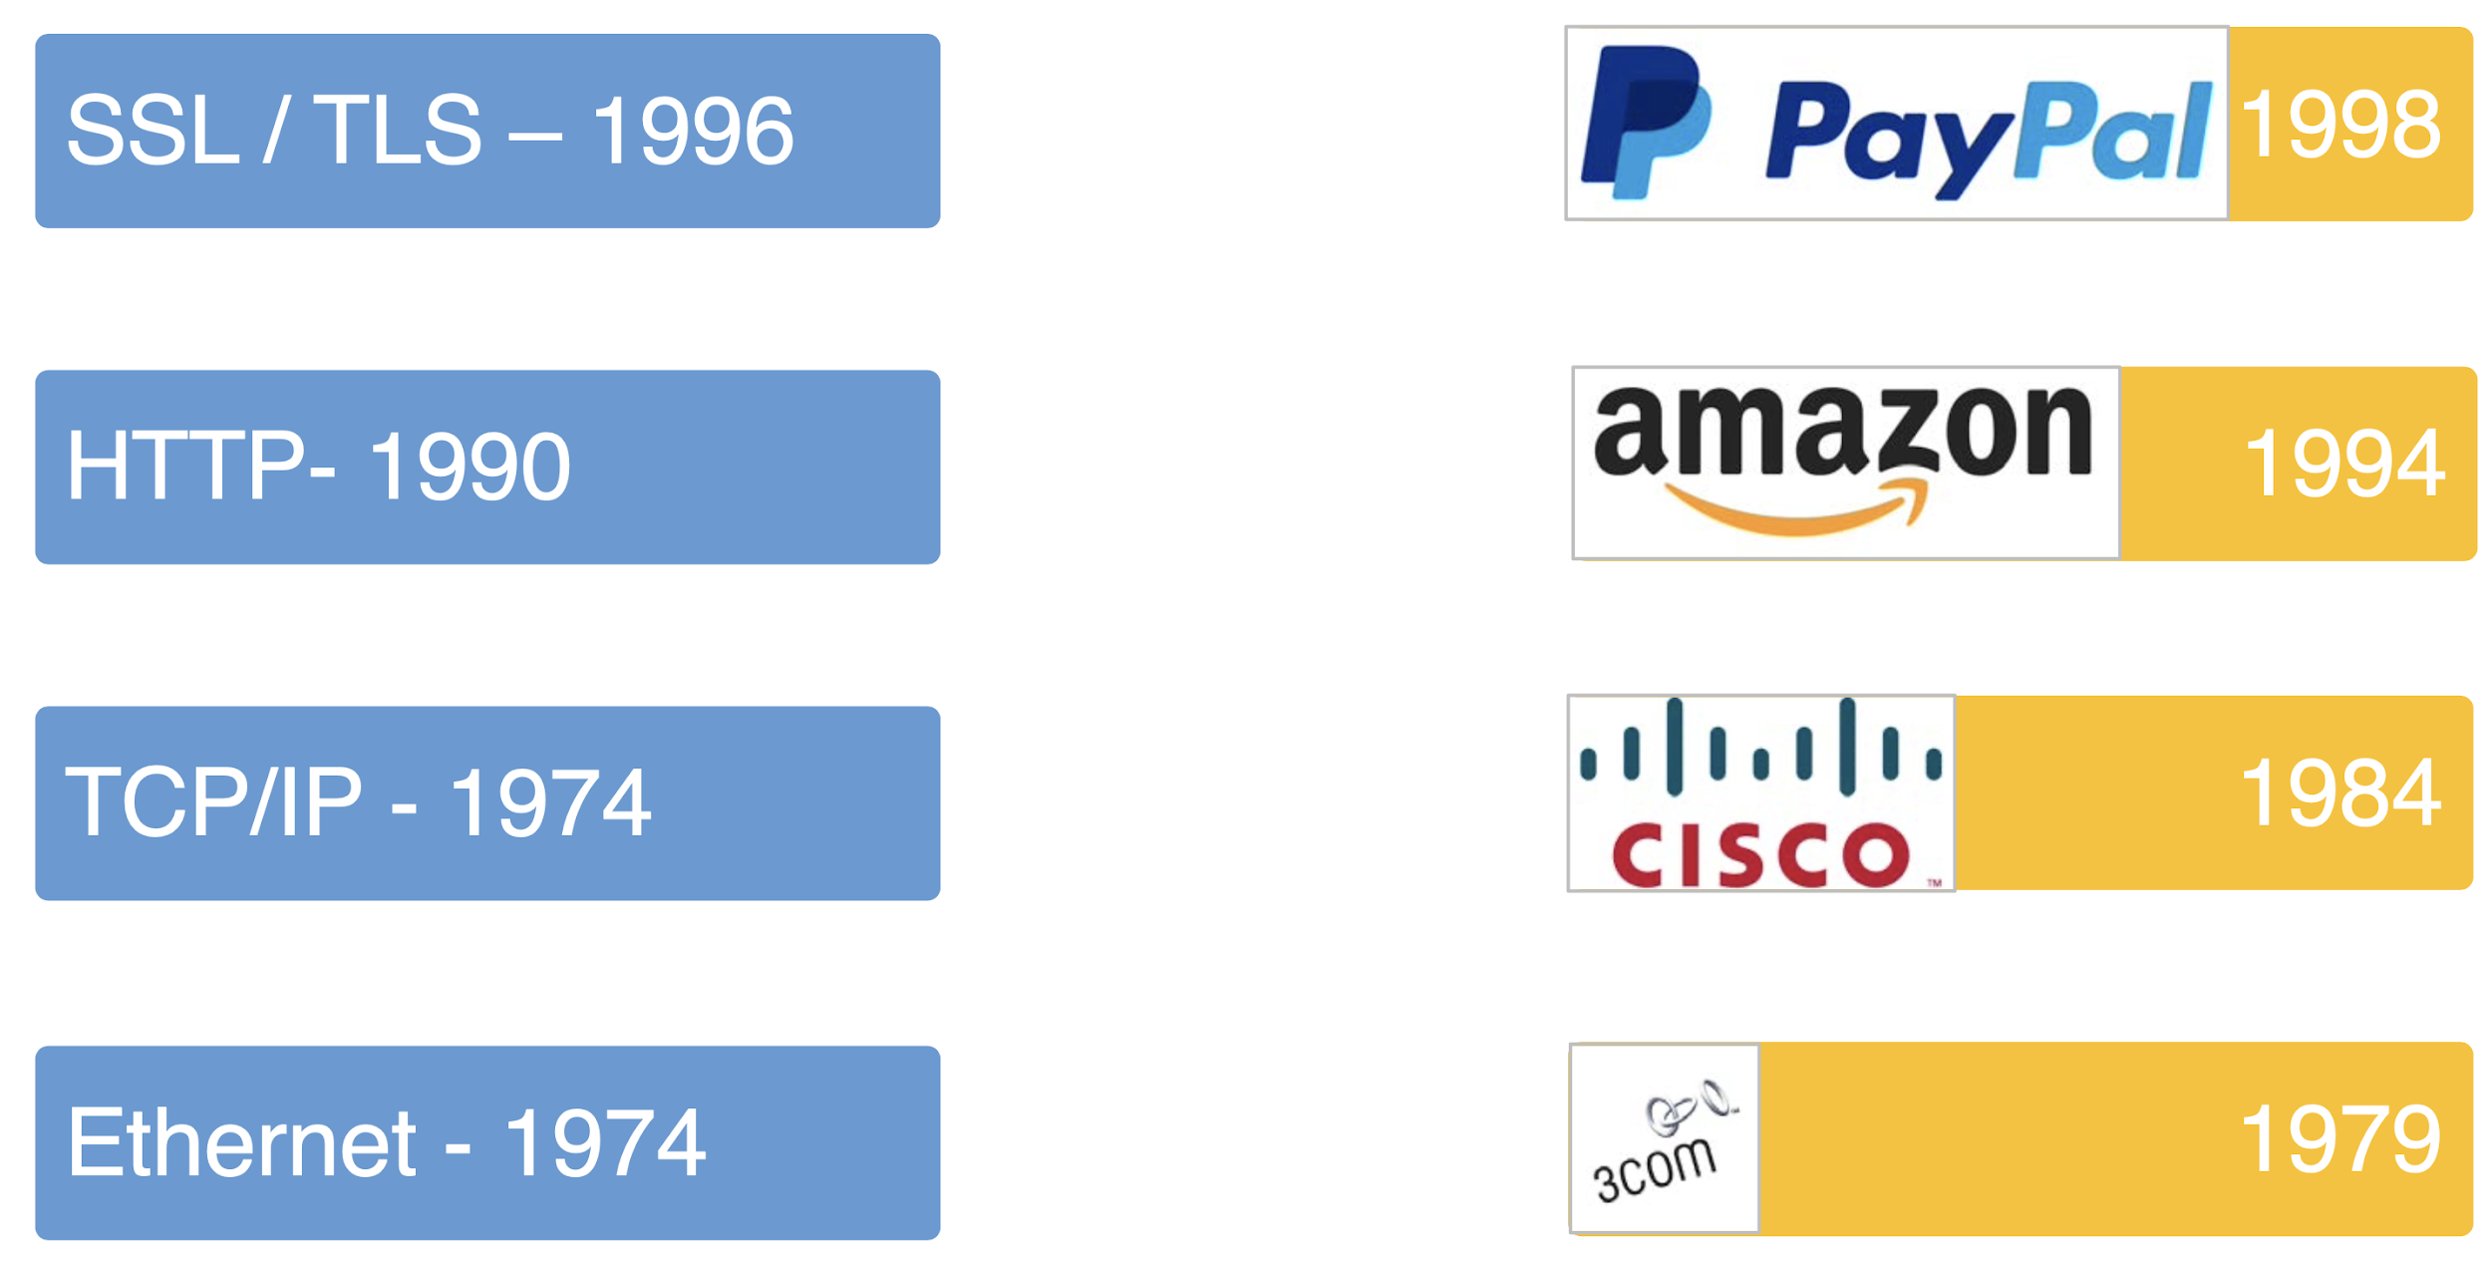
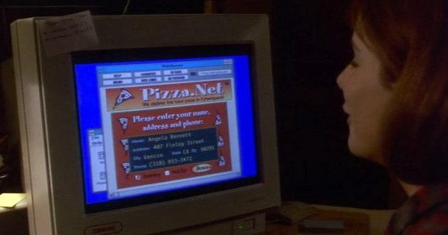
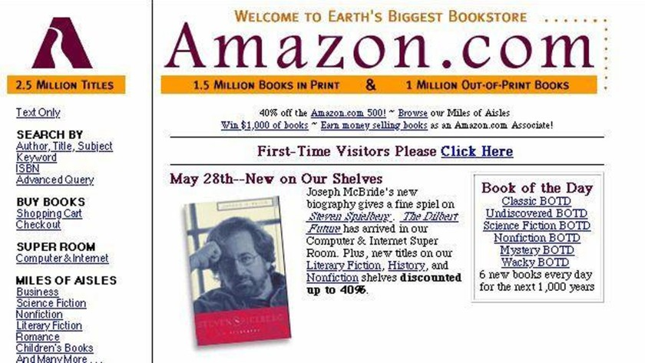
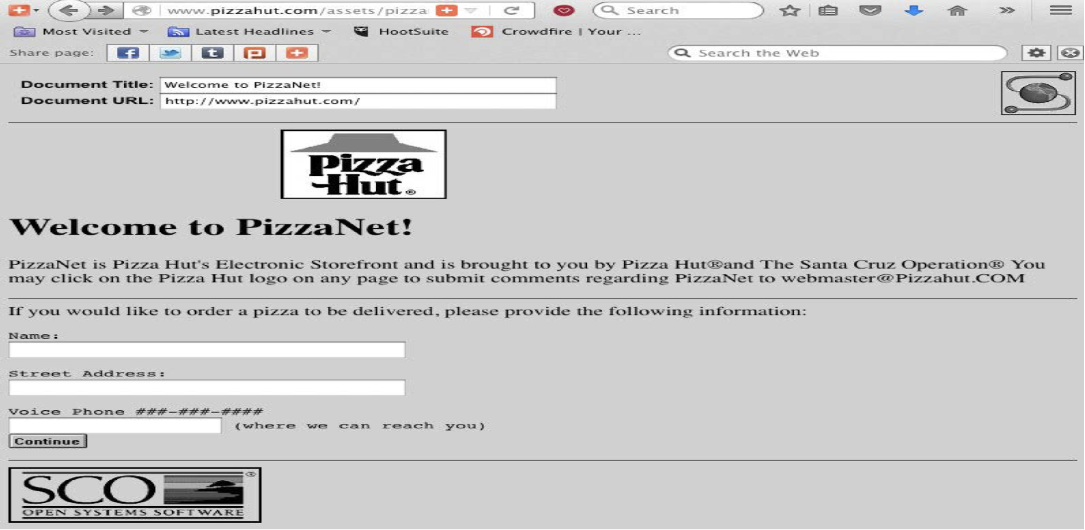
History of Internet
The Internet
Ethernet
TCP/IP Protocol
HTTP and HTML
SSL / TLS
Payment in Internet
How to Transfer $
Cash vs Credit
Avoid Cheating?

Slide 5
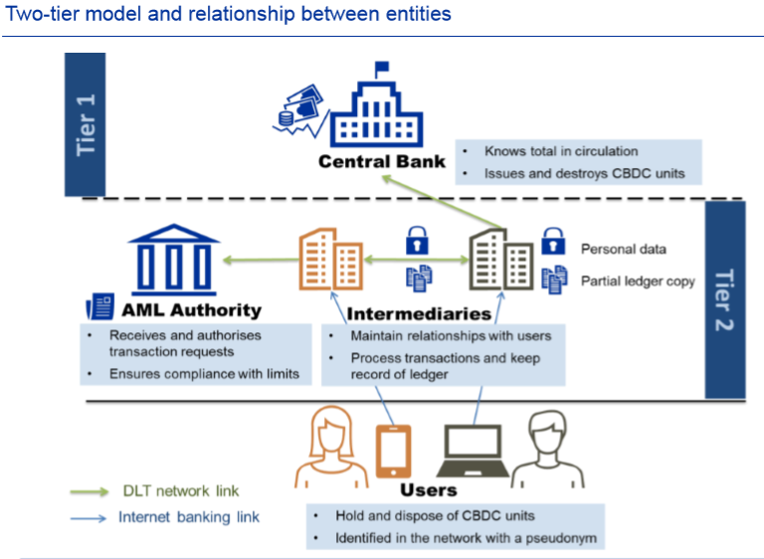
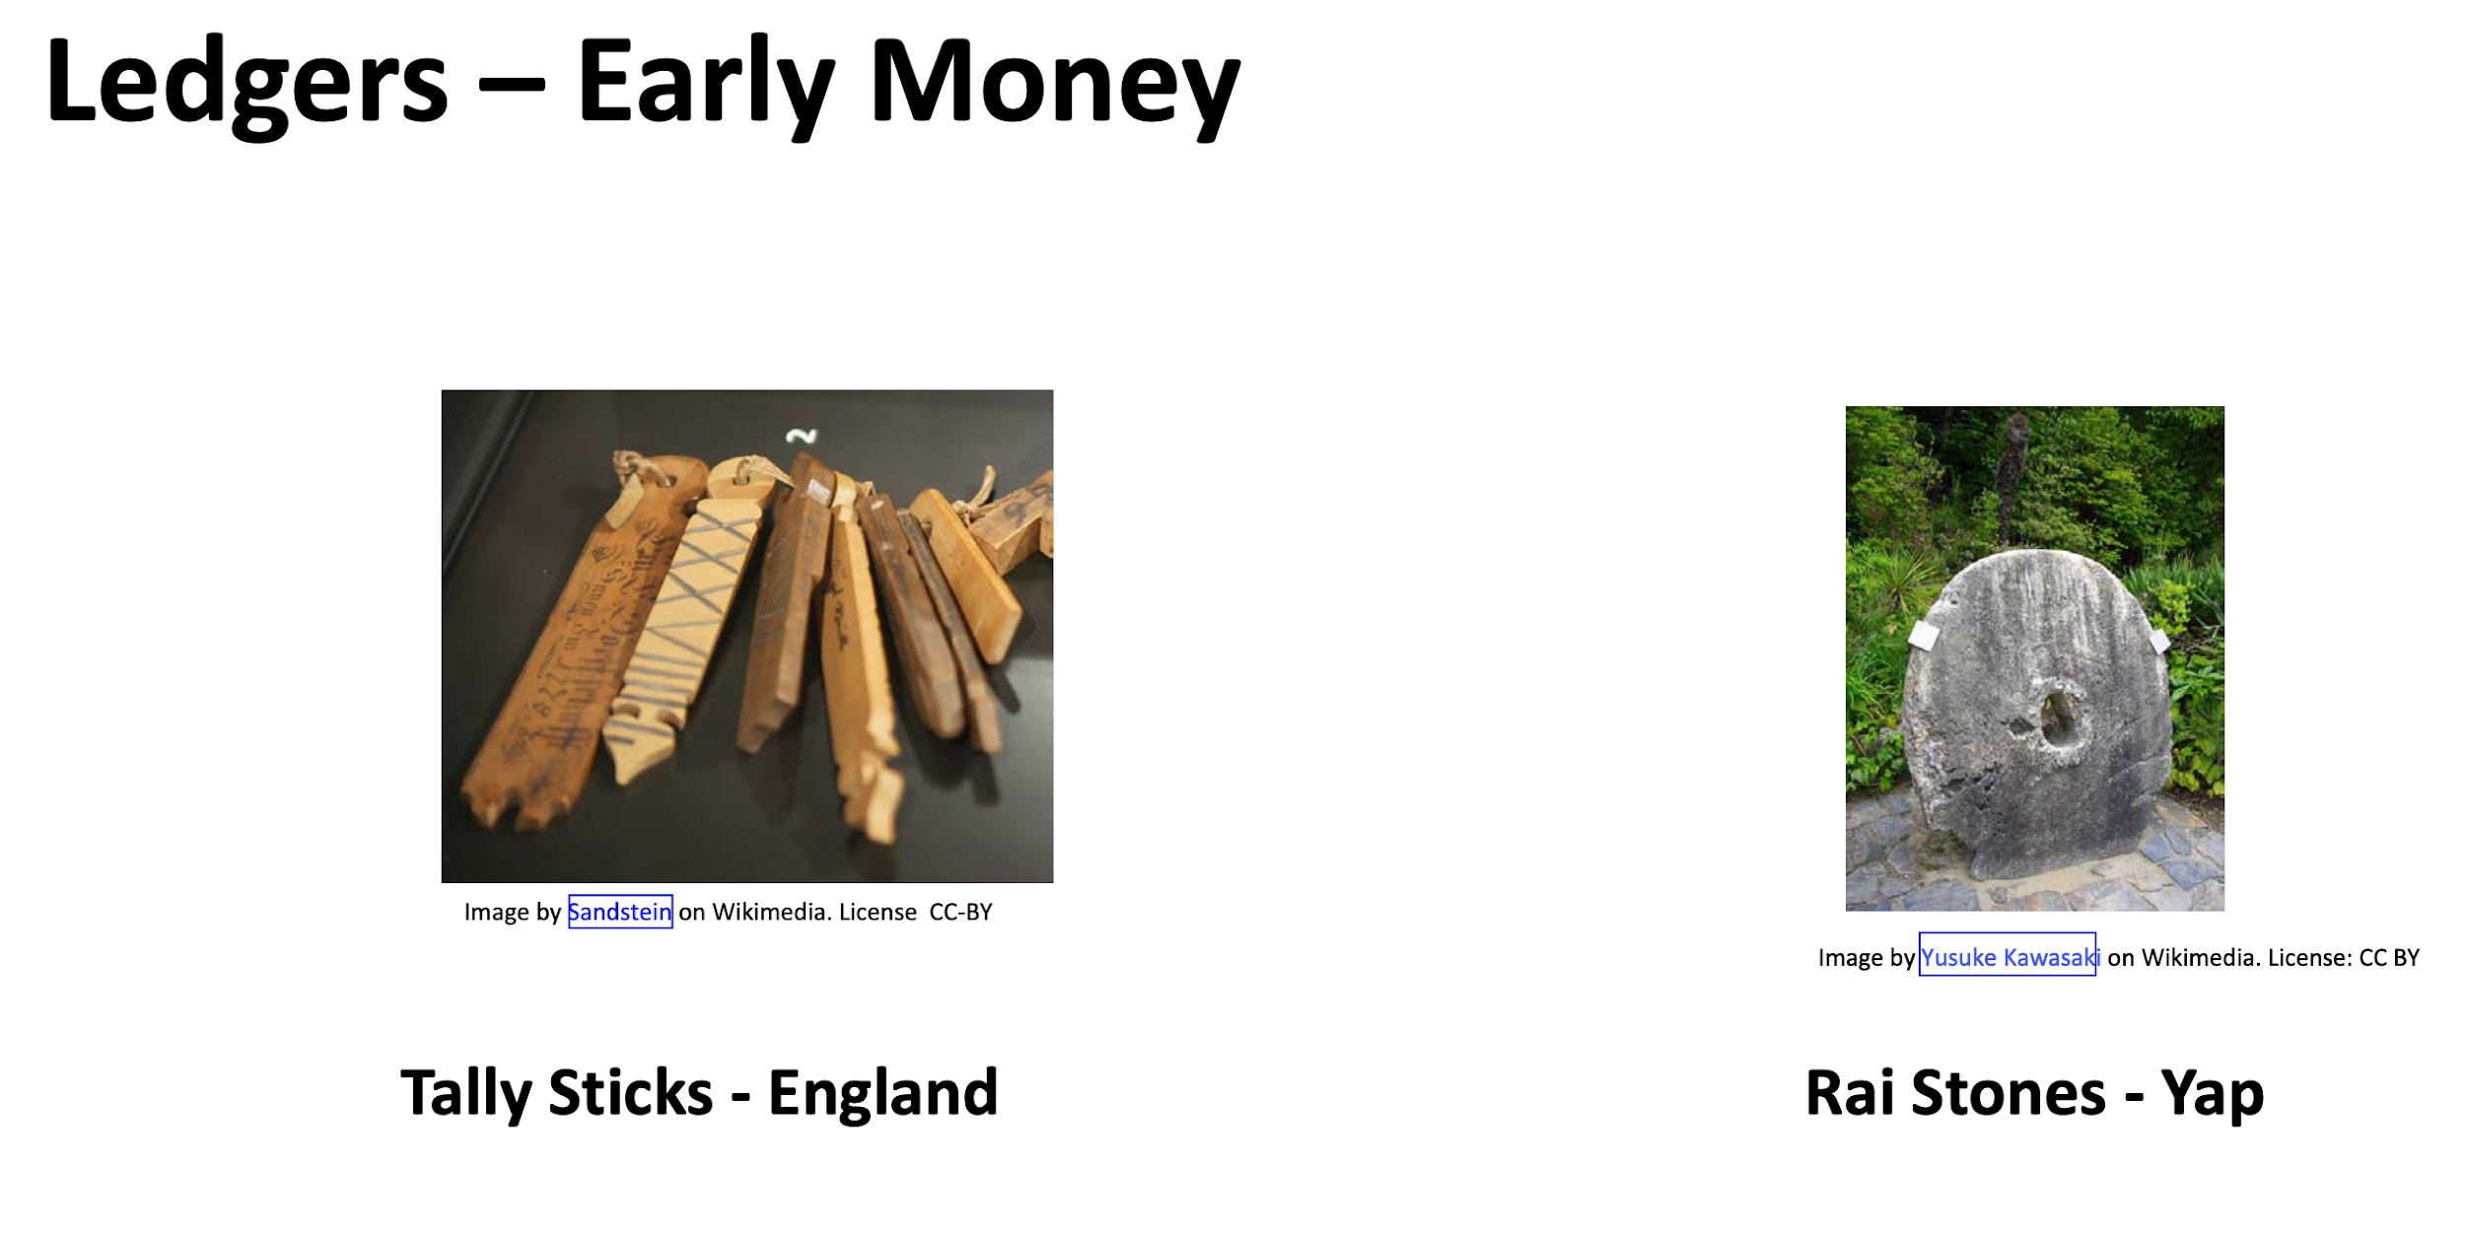
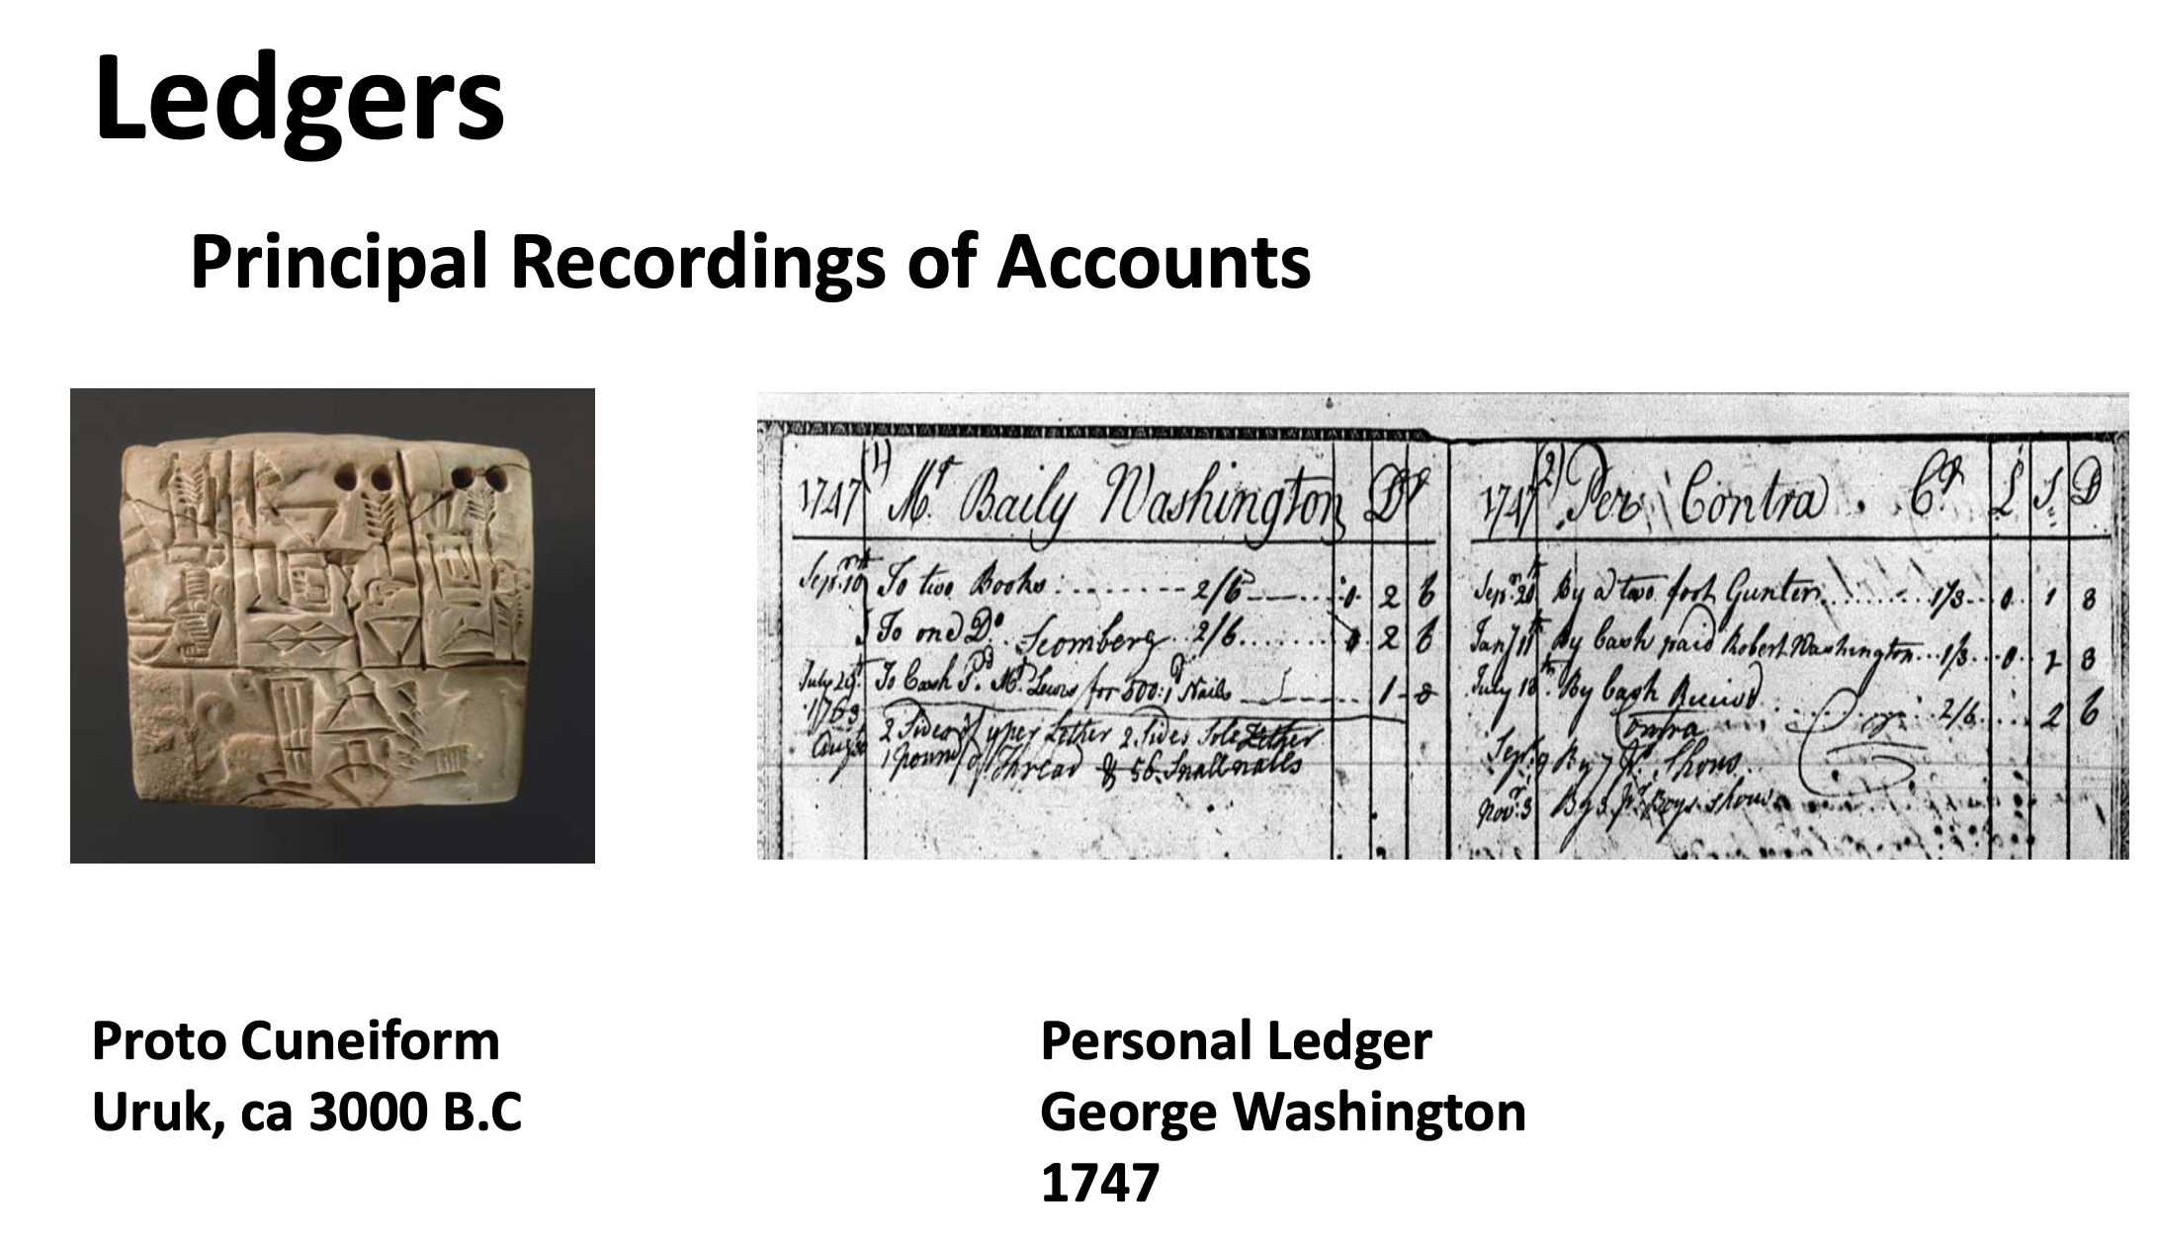
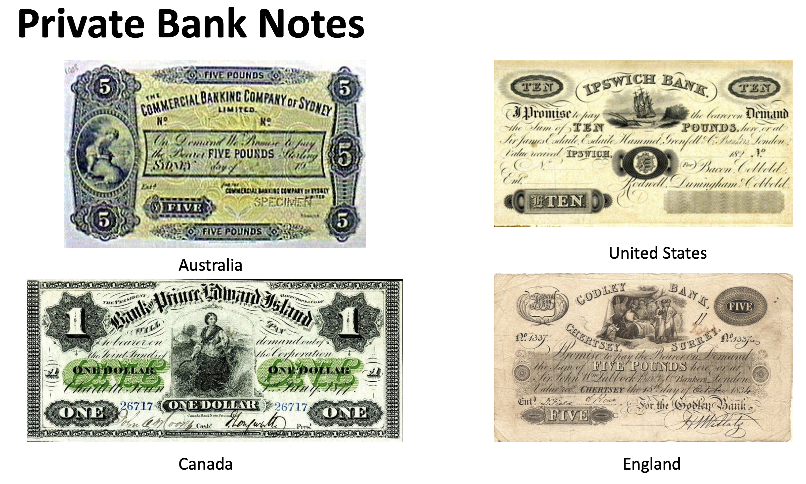
The Bank Ledger
Types of Ledgers
Transactions vs Balance
General vs Supporting or Sub
Single Entry vs Double Entry
Characteristic of Good Leaders
Immutable and Consistency
Timestamped
Ownership
Accuracy and Comprehensive
Description of Transaction
Current Structures
Central Bank
Commercial Bank
Financial Users
Recording of Accounts
Economic Activities
Financial Relationships

Slide 6

The Design of Cash Money
Durable
Portable
Divisible
Uniform/Fungible
Acceptable
Stable - Limited supply - Hard to Counterfeit
Token vs. Account Based
Physical vs. Digital
Private Sector vs. Central Bank
Widely Accessible vs. Wholesale

Slide 7
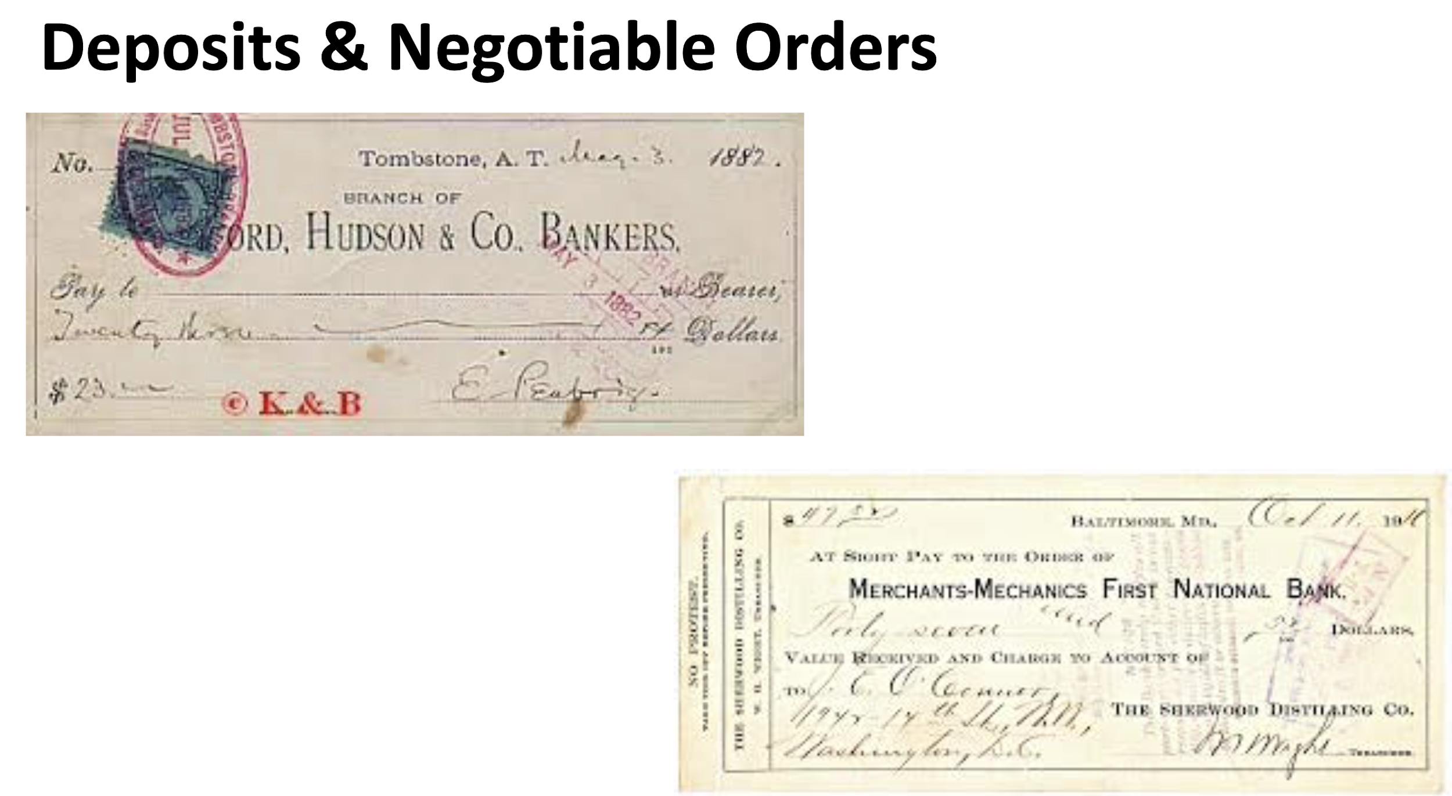
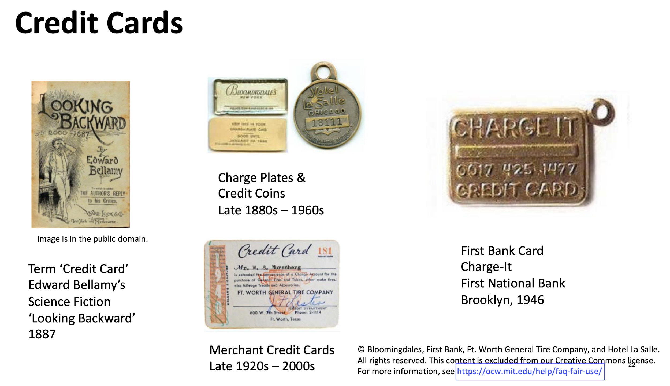
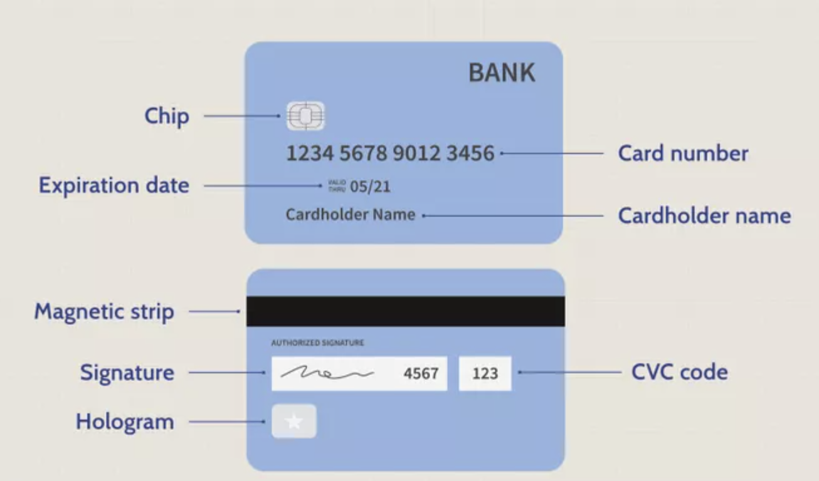
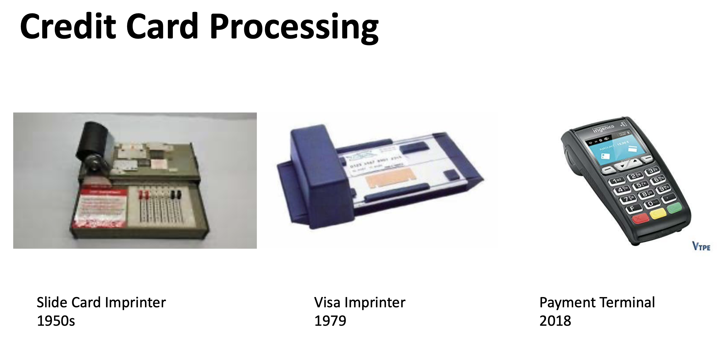
Credit Card
A credit card is a payment card issued to users (cardholders) to enable the cardholder to pay a merchant for goods and services based on the cardholder's accrued debt (i.e., promise to the card issuer to pay them for the amounts plus the other agreed charges). The card issuer (usually a bank or credit union) creates a revolving account and grants a line of credit to the cardholder, from which the cardholder can borrow money for payment to a merchant or as a cash advance.

Slide 8
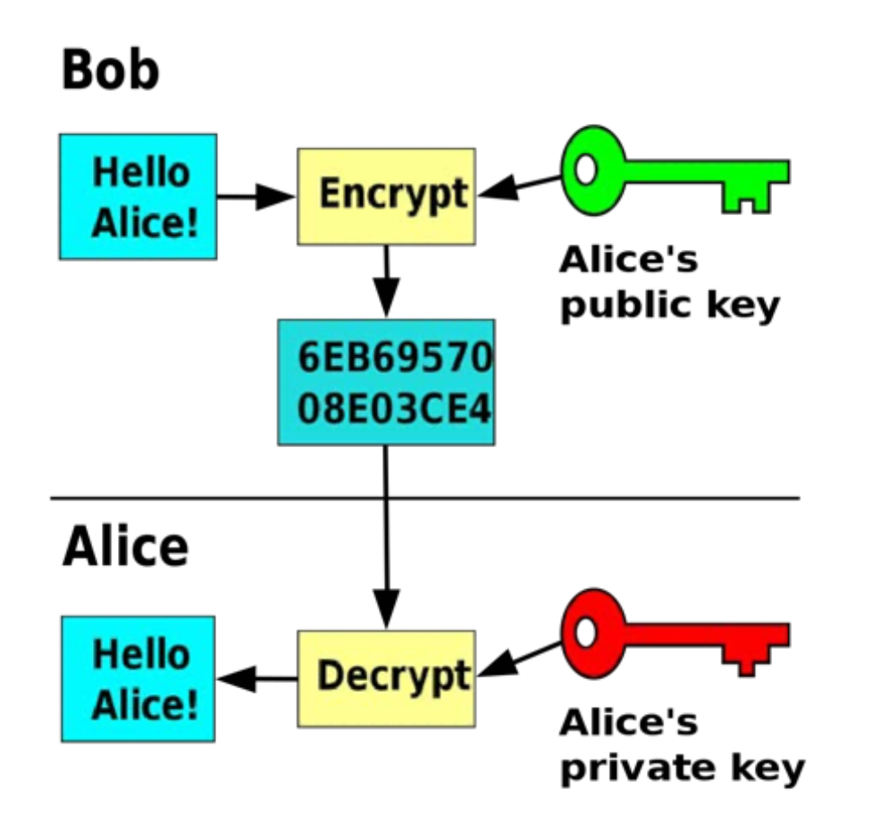
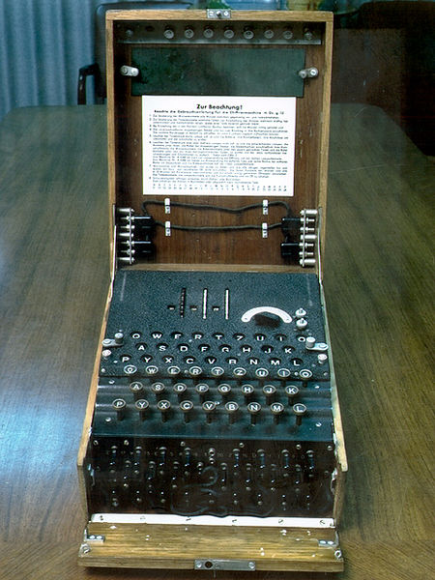

HISTORY OF CRYPTOGRAPHY
Scytale Cipher
Ancient Times
Asymmetric Cryptography
1976 to today
Enigma Machine 1920s - WWII
Communication in the presence of adversarial.

Slide 9

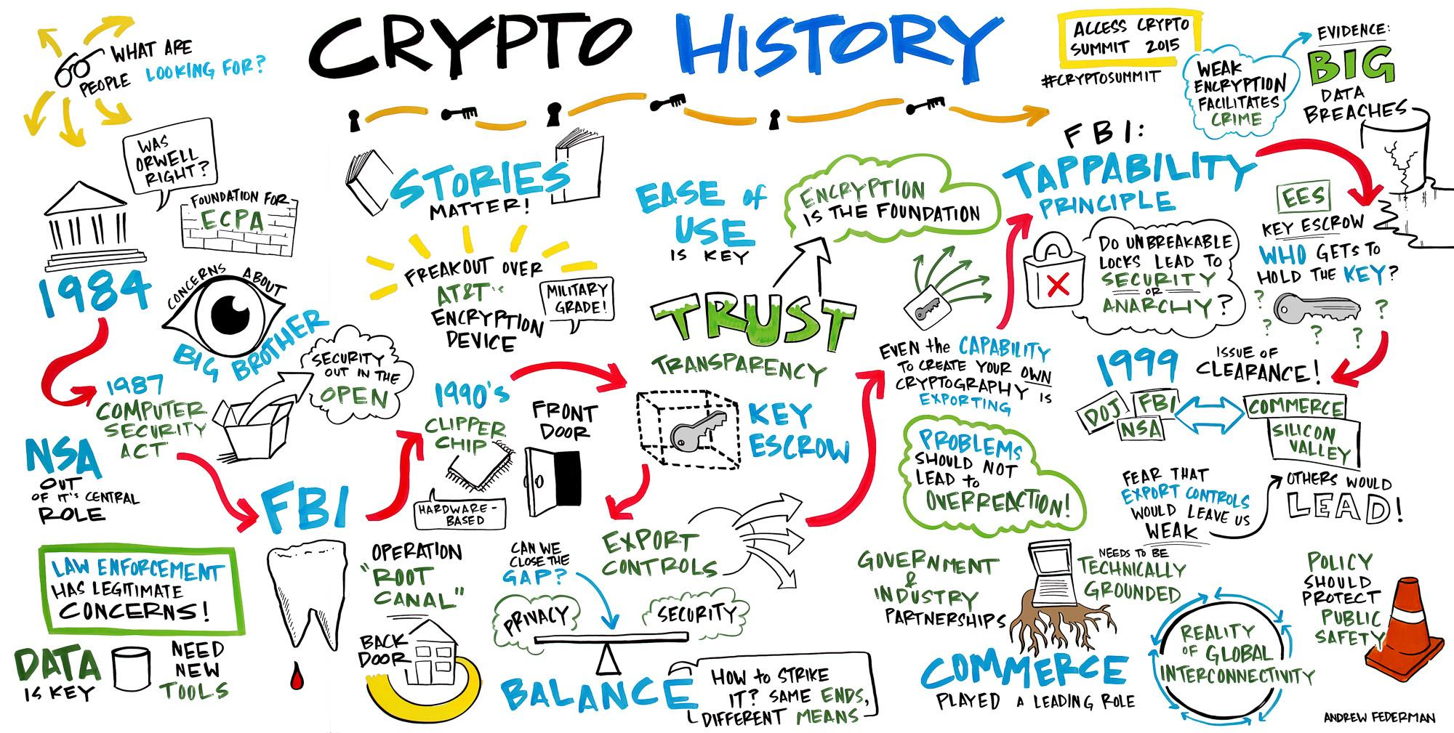
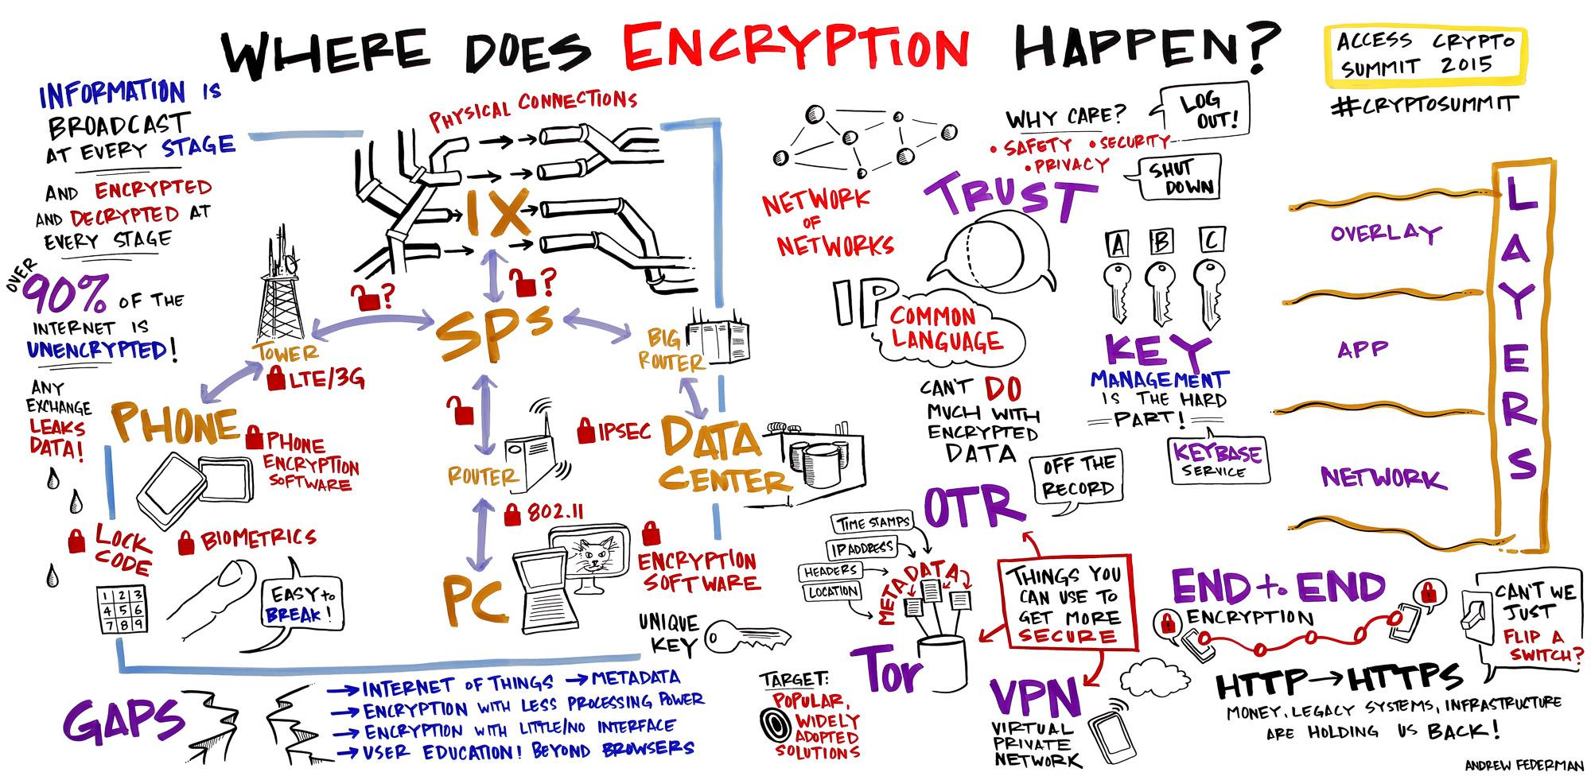
HISTORY OF CRYPTOGRAPHY
Communication in the presence of adversarial.

Slide 10
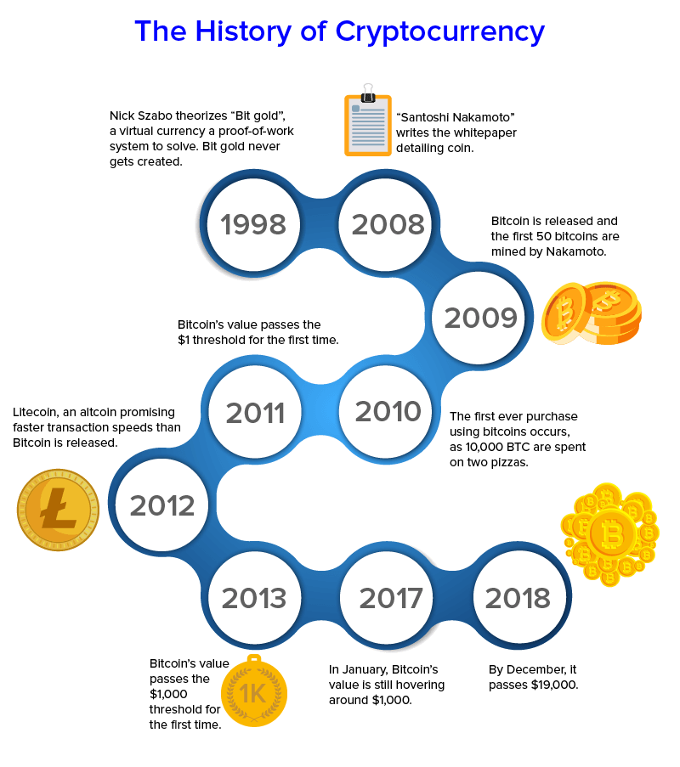
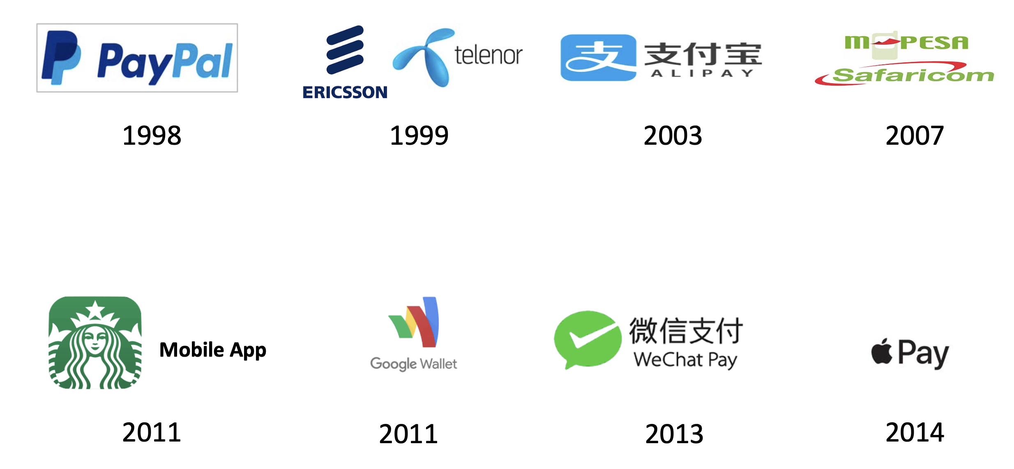
ELECTRONIC PAYMENT
Why They Have Failed?
Merchant Adoption and Centralization,
Double Spending and Consensus

Slide 11
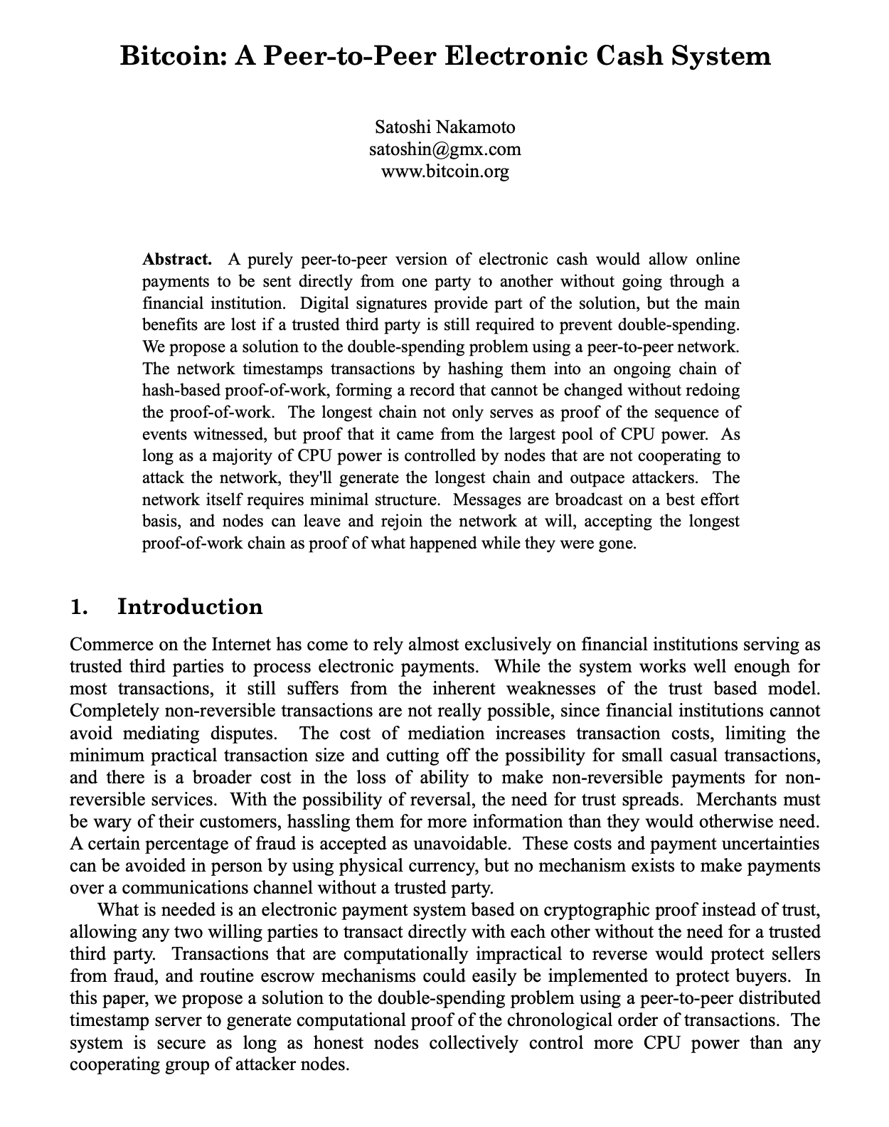
Satoshi Nakamoto
He focused to solve "double spending problem" in e-Payment by proposing "Chain of Hash" as proof or work and digital signature solution. It is cryptographic proof without "third parties" that is implemented as P2P distributed timestamp server with additional features like incentive, reclaim disk space, payment verification, combining / splitting value and privacy protection. All are implemented using well known algorithms in Cryptography and Distributed System.
“I've been working on a new electronic cash system that's fully peer-to-peer, with no trusted third party.” Satoshi.

Slide 12

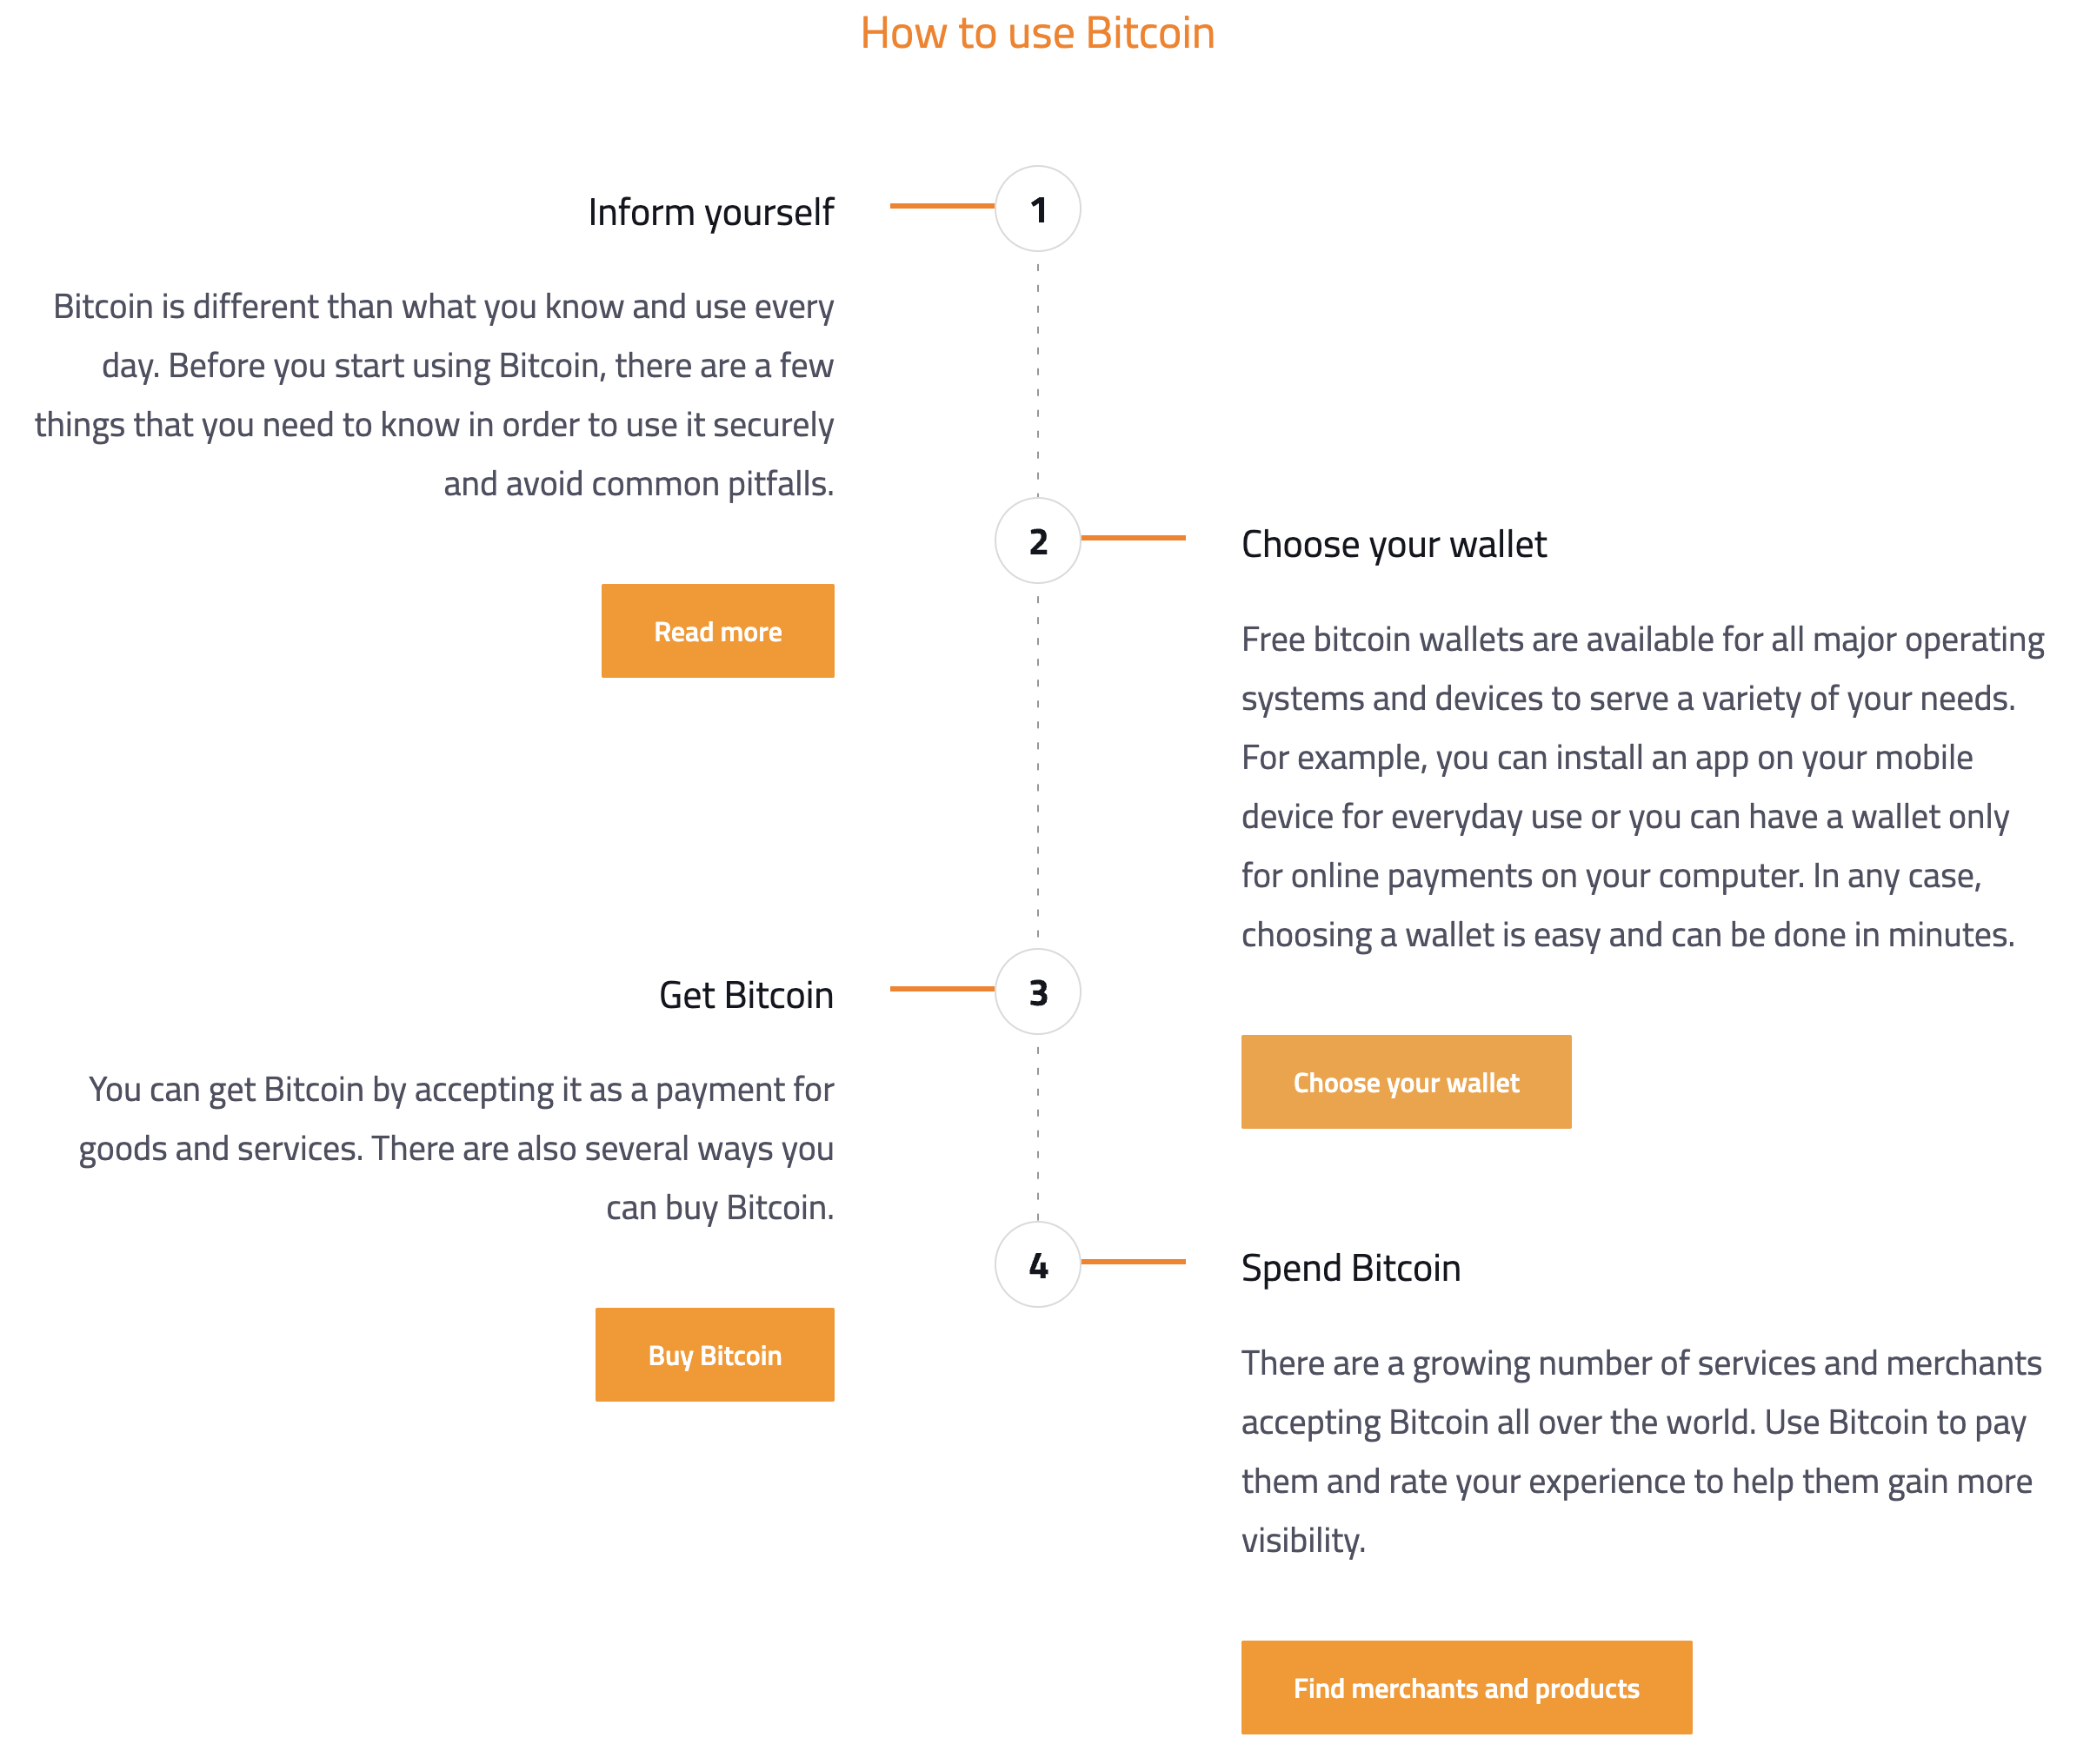
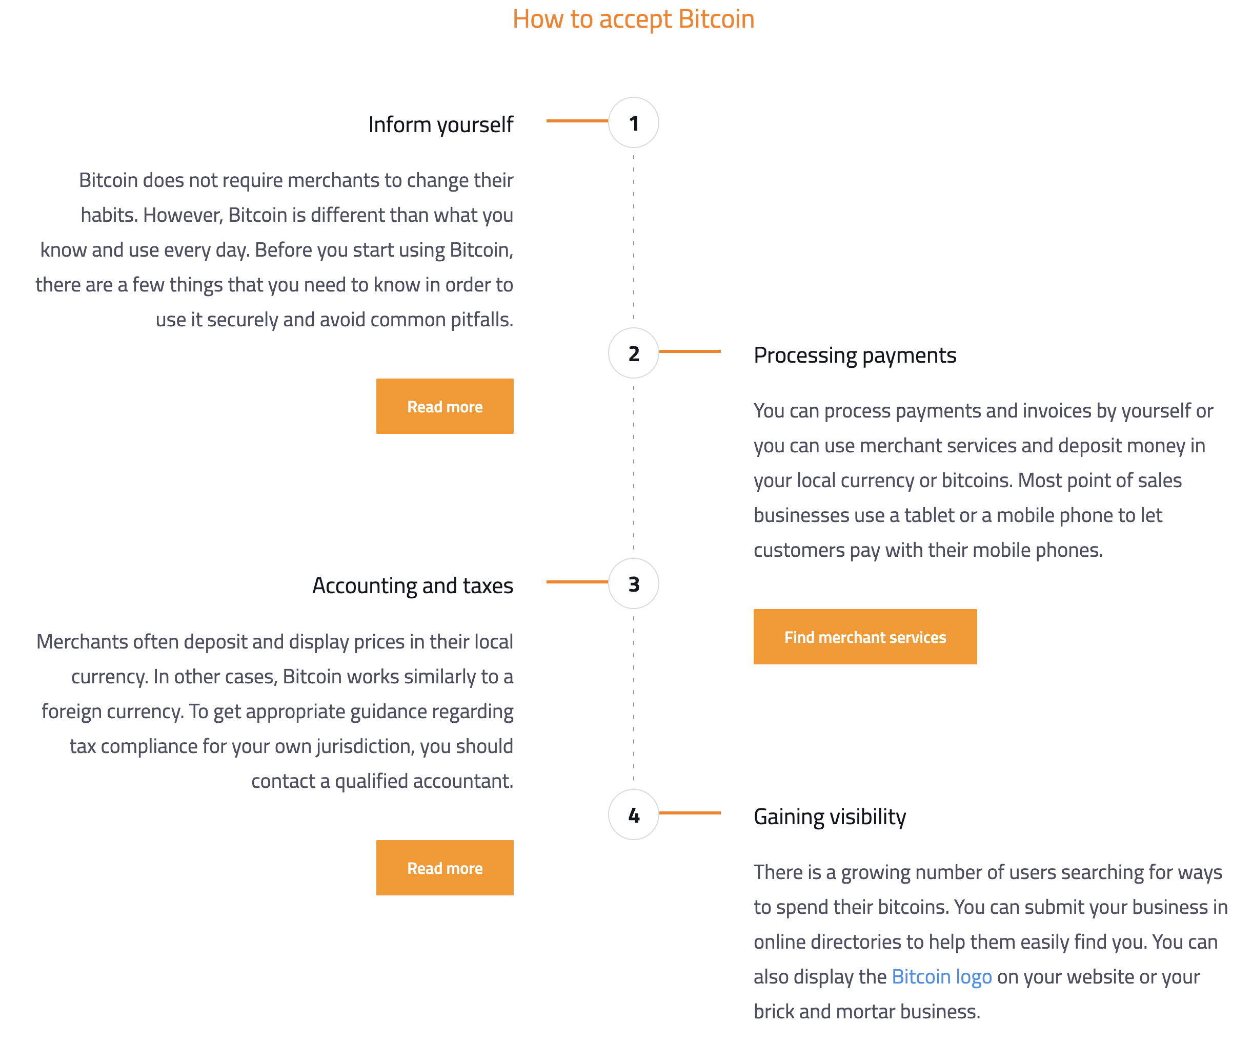
Overview of Bitcoin
Bitcoin is largest Blockhain tthat innovates WW payment network and a new kind of money.
Bitcoin uses P2P transaction technology to operate with no central authority or banks;
Managing transactions and the issuing of bitcoins is carried out collectively by the network.
Nobody owns or controls Bitcoin, everyone can take park and offers low processing fees.

Slide 13
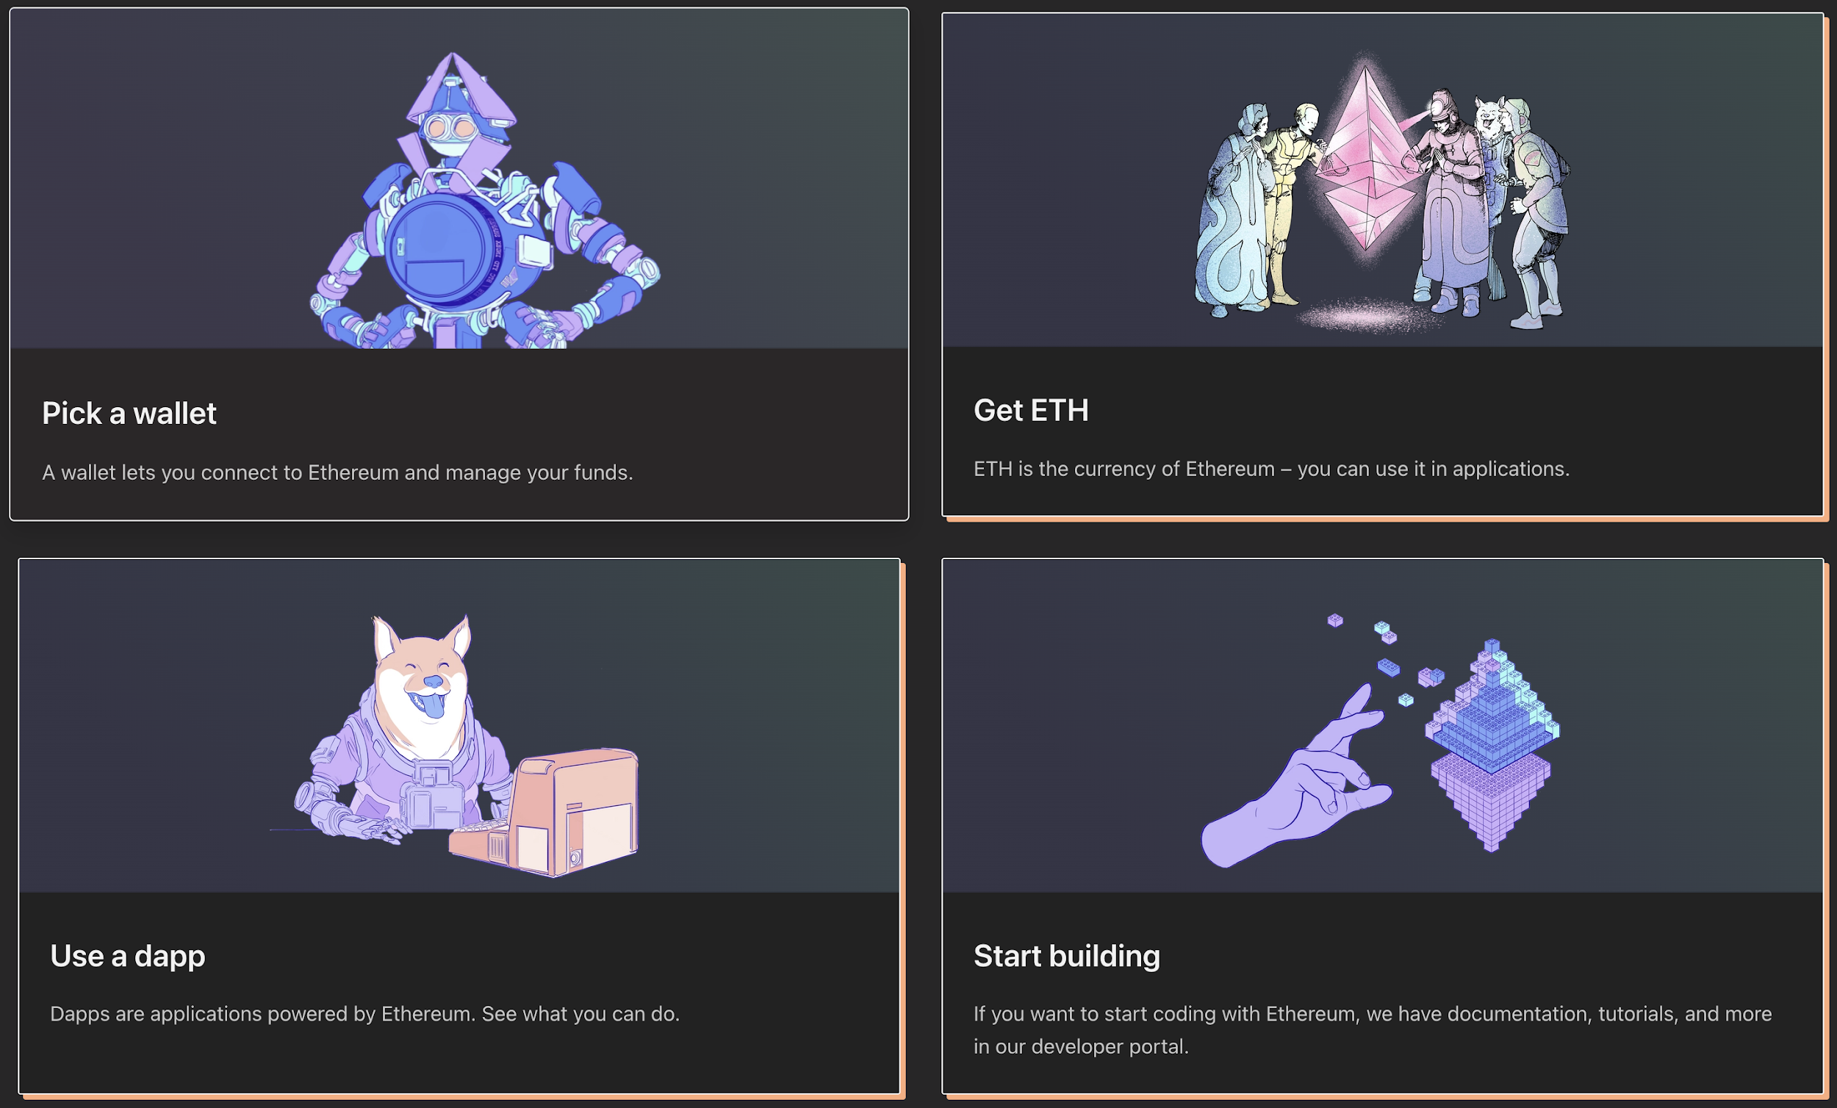
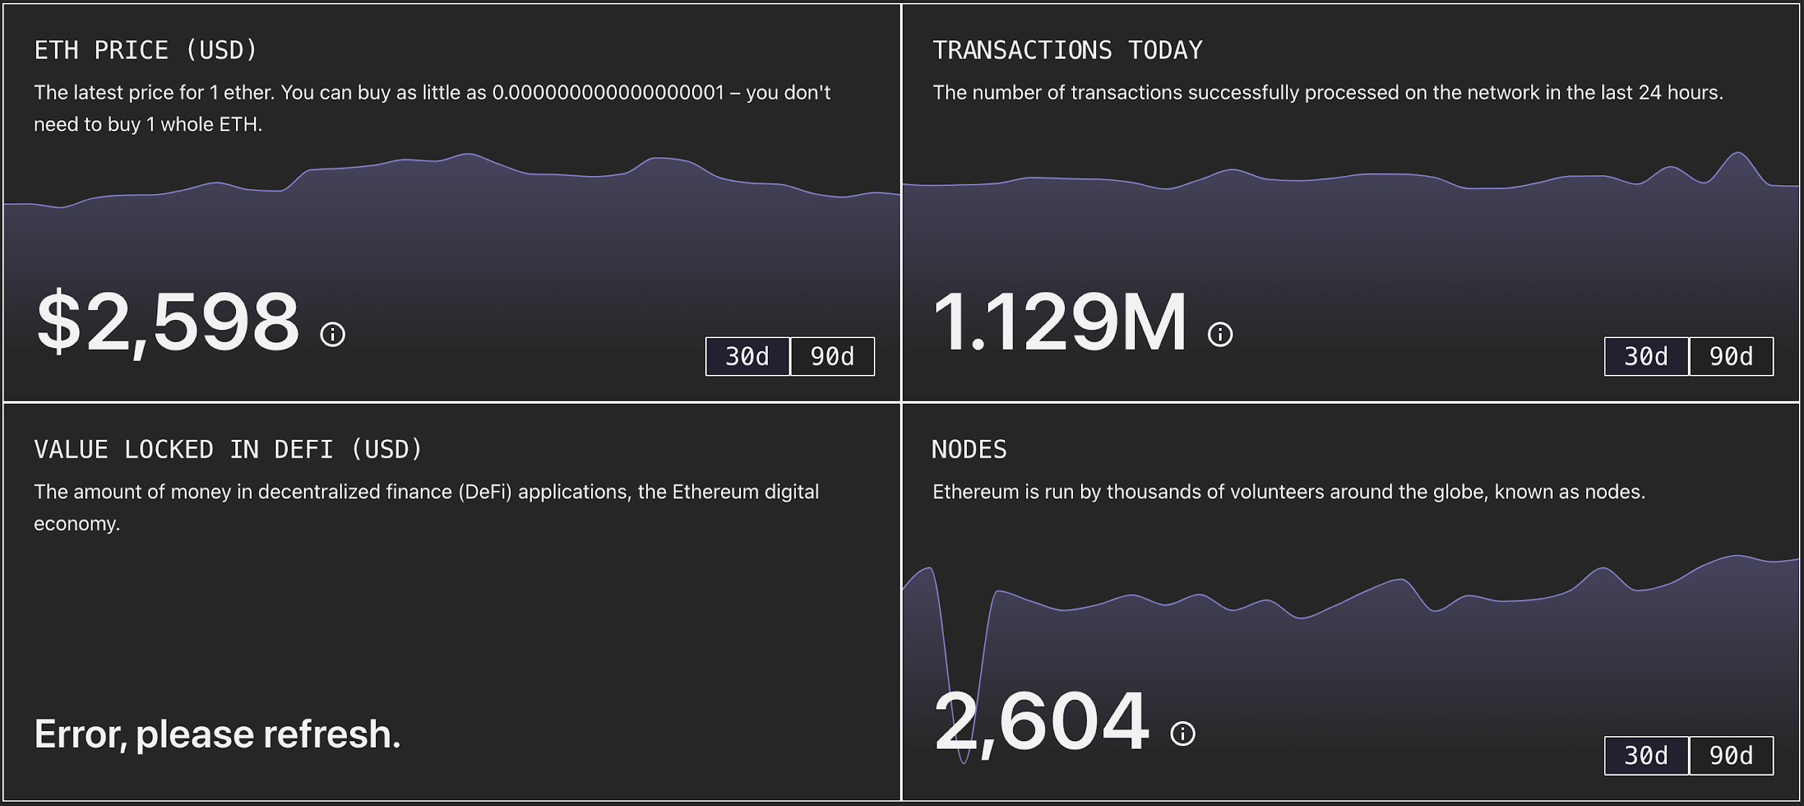
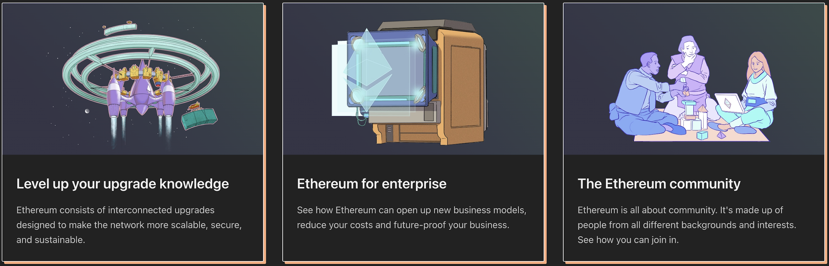
Overview of Ethereum
Next Talk: Hash Function, SHA, Hash Pointer and Merkle Tree
Ethereum is OSS powering the cryptocurrency ether (ETH) and thousands of DApps. To make digital money, global payments, and applications. The Ethereum community has built a booming digital economy, bold new ways for creators to earn online, and so much more. It's open to everyone, wherever you are in the world – all you need is the internet. Future Ethereum is:
The Internet of Digital Assets (NFT - Non Fungible Token)
A Fairer Financial System (DeFi – Decentralized Finance)
An Open Internet (eWallet – Secure, Free and Easy Wallet on Internet)
A New Frontier of Development (DApps – Distributed Apps)

Slide 14
W1 Home Works
Reading and Watching:
Read Satoshi Nakamoto Paper and Summarize
Getting Started with Bitcoin (www.bitcoin.org)
Getting Started with Ethereum (www.ethereum.org)
Find Your Favorite Youtube Videos that Explains Bitcoin and Ethereum
Code Hacking:
Ethereum uses the Keccak-256 cryptographic hash function in many places.
Learn ETH-Hash Implementation: https://github.com/ethereum/eth-hash
Ethereum uses Merkle Tree for Offline Data Integrity:
https://blog.ethereum.org/2015/11/15/merkling-in-ethereum/
https://ethereum.org/en/developers/tutorials/merkle-proofs-for-offline-data-integrity/
Make Simple Codes That Uses ETH-Hash and Put in Your Git

